Slide 1
Technical Section
Will be presented by Angshuman Barpujari(developer and Coder of InCovid)

Slide 2
Module Description as technical manner
Redzone listing
User can scroll through a list of redzone in the app. When user click on in It, it will show the place on map(move the camera to the location)
Safeness monitor
On the basis of recent travels the app will let you know if you’re safe or not.
Covid 19 symptoms input
If you have any symptoms, input in the app and it will be sent to our server. Then we’ll review it then send the info to the authorizers.
View map freely and can see where is the redzone
Dynamic map with redzone circles in it.

Slide 3
Module Description as technical manner
Nearby emergency location(nearby hospitals, restaurants, groceries, banks)
When user click the buttons like groceries, banks the app will pin point the nearest location in the map
Search location
You can also manually search location in the map to ensure if the place is not near a redzone
Nearby redzone notification
If you’re near a redzone a notification will be sent to you
Toll free nos
You can view, copy, call toll free no from the app

Slide 4
System Design
We can divide the backend design the following points
Location fetch
Database fetch
Authentication
Safeness tracker
API fetch
Map integration

Slide 5
System Design
Location fetch
For location fetching we used fusedLocationProviderClient.
Using the former we have to do all the hard work optimization whereas fusedLocationProviderClient do all the hard work for you(e.g. Battery optimization).
BANDWIDTH UTILIZATION: We know every one have limited bandwidth and data. So we implemented the location that way that it doesn’t continuously fetch location. We used a TimerTask to fetch location on an interval of 1 minute.

Slide 6
System Design
Location fetch
What is the desired location accuracy?
The accuracy may not be 100% accurate. As long location is in the radius of 100m is enough. FusedLocationProviderClient is used for fetching location. In the official documentation google claim to fetch accurate data with low battery uses.
Should the location be shared even if the app is killed or in background?
We need to monitor the user location every time, even the app is destroyed or in background. A service is created to handle this location fetching. Even a notification module is attached in this service to show notification when user is near a red zone.
Do we need to store the location data on device?
We don’t want to violate user privacy. That is why we will not store the location of user. Only when he is near redzone his name and the location need to be sent to authorization.

Slide 7

System Design
Database fetch
Database section of the app is the most complex area of the system. We tried to build a cost free database using verity of existed database system. We used Firebase Firestore, JSON, ROOM(SQLite) in a combined manner to achieve a cost-free database structure. Following is the diagram of the database system we used.
ROOM
JSON
FireStore
Our app
In Room we cache the data for offline uses.
In JSON the main data is stored.
Get URL for the JSON, if JSON is change the link also change so it will re-fetch the URL

Slide 8
System Design
Database fetch
Do we really need cached database?
Without a cache database the app cannot provide the data stored in server to user when internet is disabled.
Why not fetch from firebase instead of creating this complex database system?
The firebase is not free. It give us a limited free nos of data fetch, 10000 document read per day. Where if we have 100 redzone data, then only 100 times a day data can fetch. If a user fetch 10 times a day then we can only serve 10 user per day, which is not what we want. So in a free storage server we placed the json from which the data can be fetch many times as needed.
Schema: As firebase and JSON are noSql so they are schema less. But for cache we used ROOM who has a schema. (next page)

Slide 9
System Design
Database fetch
Schema:
To cache toll-free no.
Columns:
phone no name,
phone no,
To cache redzone.
Columns:
ID,
Placename,
lat,
lon,
Radius

Slide 10
System Design
Database fetch
Schema:
To cache search history
Columns:
ID,
creation date,
place name,
place address,
lon,
lat

Slide 11
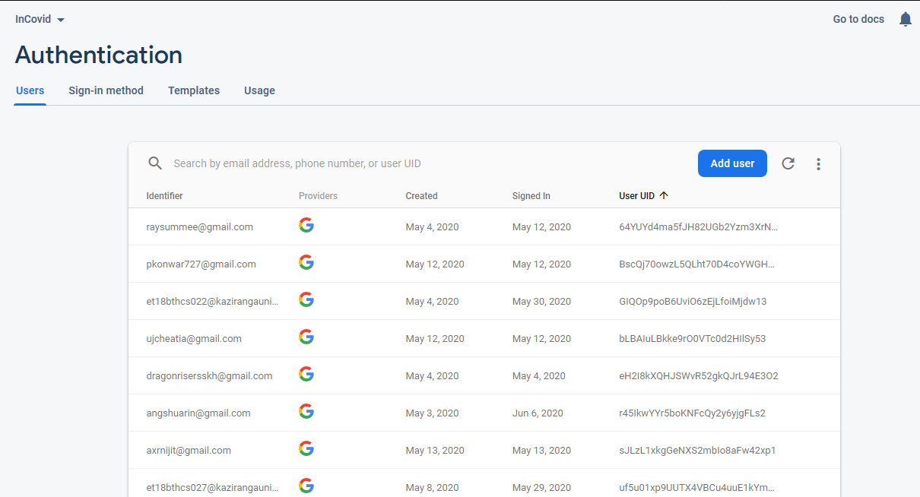
System Design
Authentication
Authentication is used here to safe this app from spam. Firebase auth API used to handle this.

Slide 12
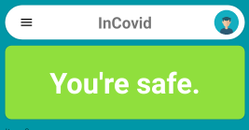
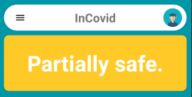
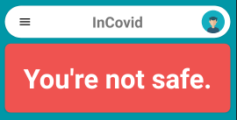
System Design
Safeness Tracker
We build a safeness tracker which will show you how much safe you are. We will compute recent distance from the redzone area to show you how much safe you are.
YOU’RE SAFE-> 100% safe
YOU’RE NOT SAFE-> Unsafe
PARTIALLY SAFE-> 50% safe

Slide 13
System Design
API Fetch
Verity of API are used in this app. They are as follows.
Geocoder forward geo-location: This API is used in search. When a user query a search it will return the coordinates of the location. Which can be use to add pins on the map.
Place API: This API is used for searching nearby restaurant, hospitals and any possible categories listed in this API.
Covid 19 API: This API is to fetch toll free numbers

Slide 14
System Design
Map Integration
Lets keep it simple. We used google map for drawing the map into our app.

Slide 15
Thank You

